Slide 1
Ornament Store

Slide 2
Submitted by:
Farjana Akther, ID: 0182220012101127
Ibnat Zareen, ID: 0182220012101006
Tahsina Hasnat, ID: 0182220012101177
Asma Begum Simran, ID: 0182220012101108

Slide 3
Purpose: Our tiny, affordable and slightly eccentric Ornament store’s database can track total money received from selling ornamental items in any month in a year. For example, we can easily see the total money earned from selling ornaments in September, 2024.
Let’s take a look at the E-R Diagram for a better understanding:

Slide 4
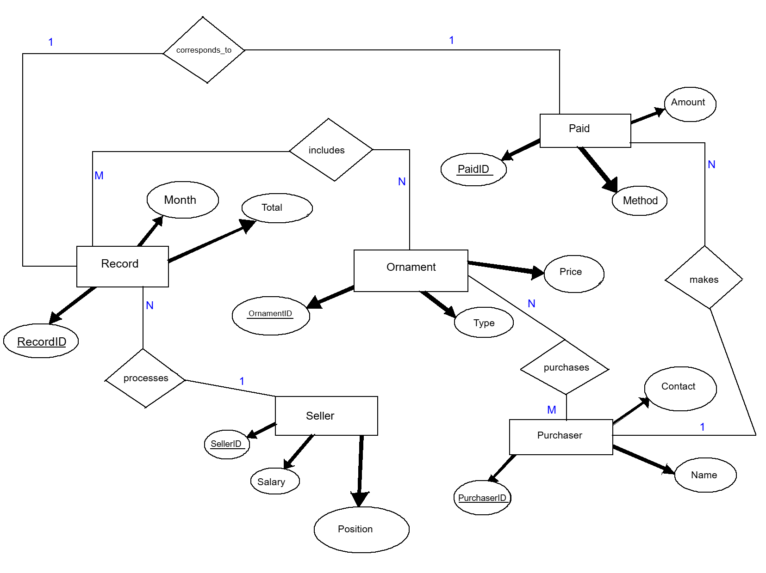

Slide 5
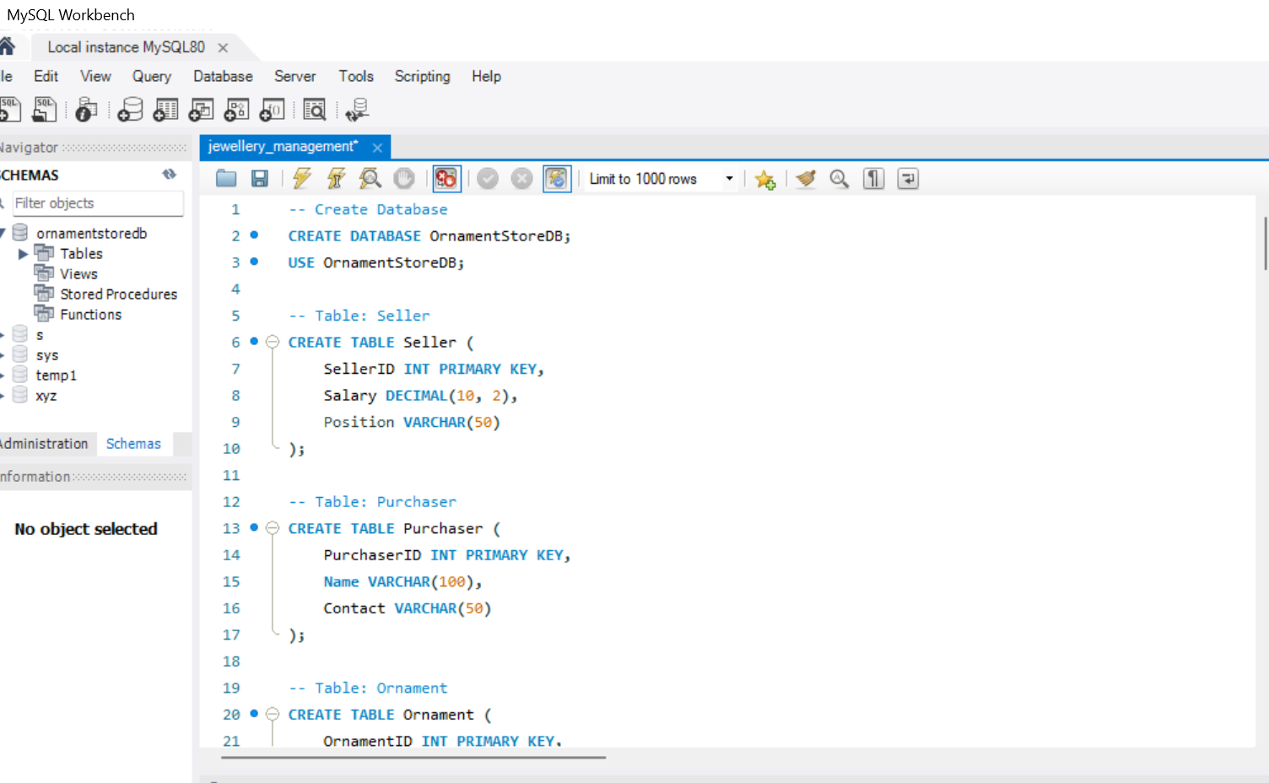
SQL code for our database

Slide 6
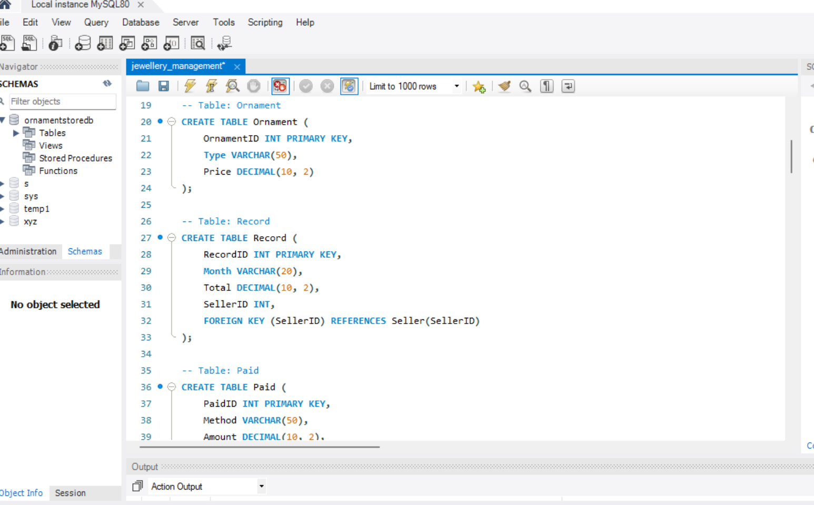

Slide 7
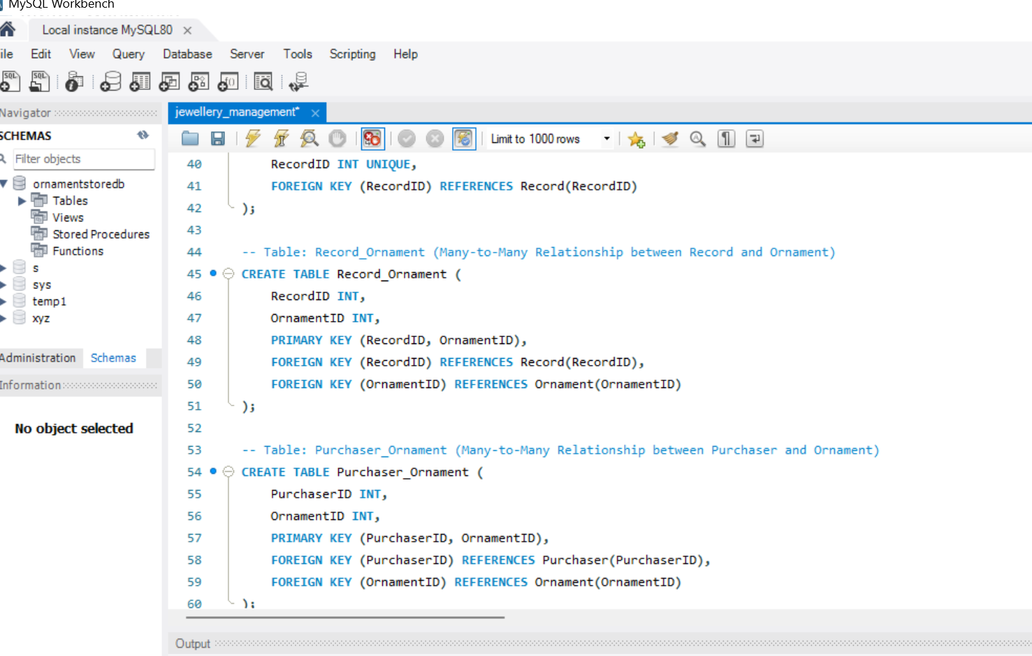

Slide 8
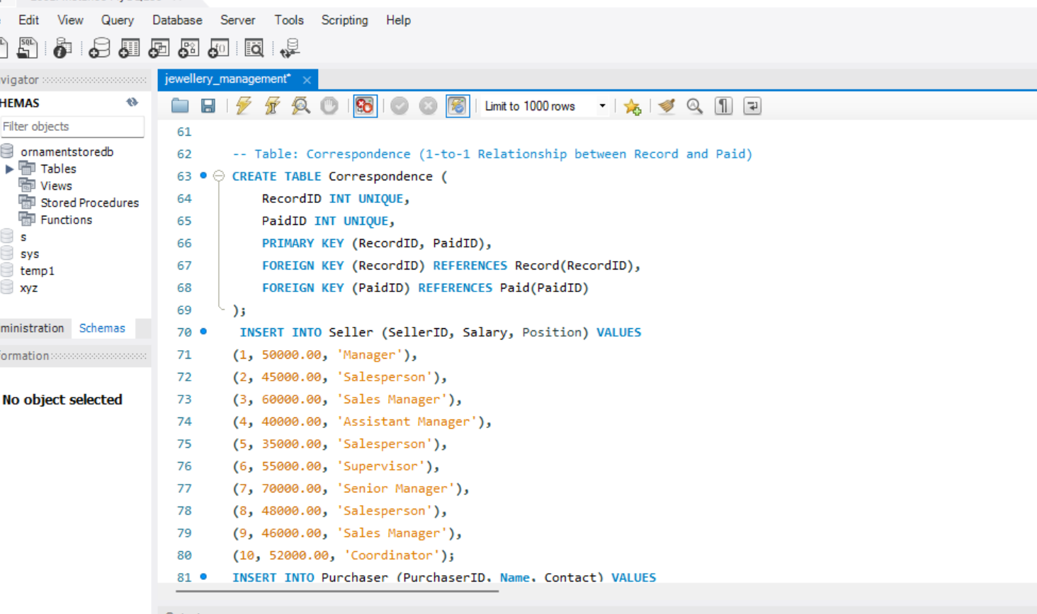

Slide 9
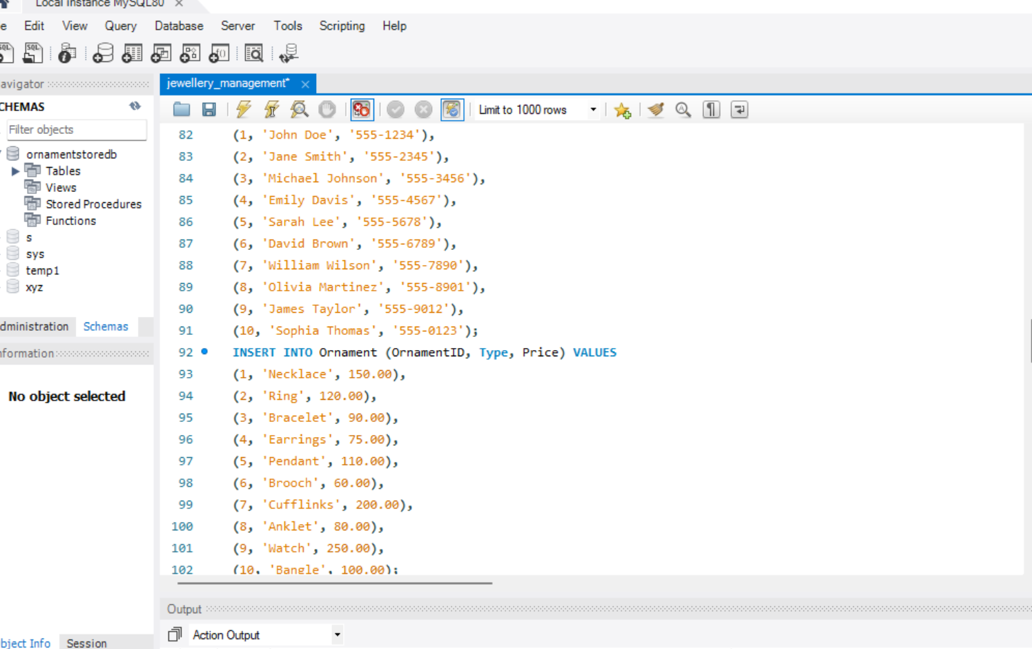

Slide 10
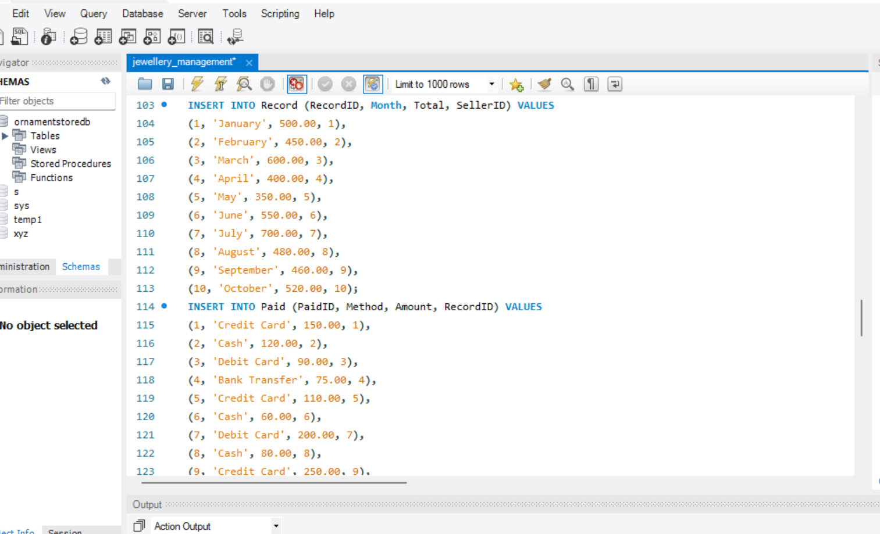

Slide 11
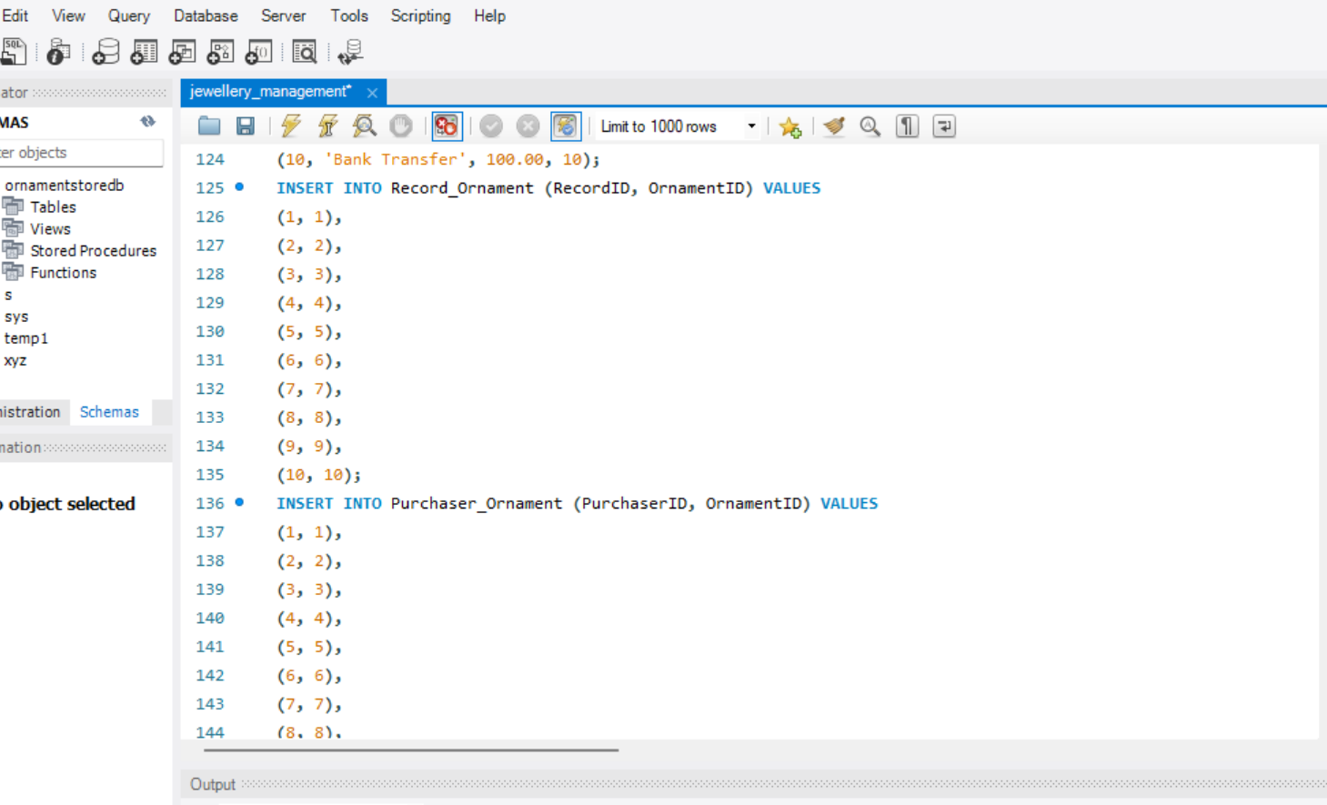

Slide 12
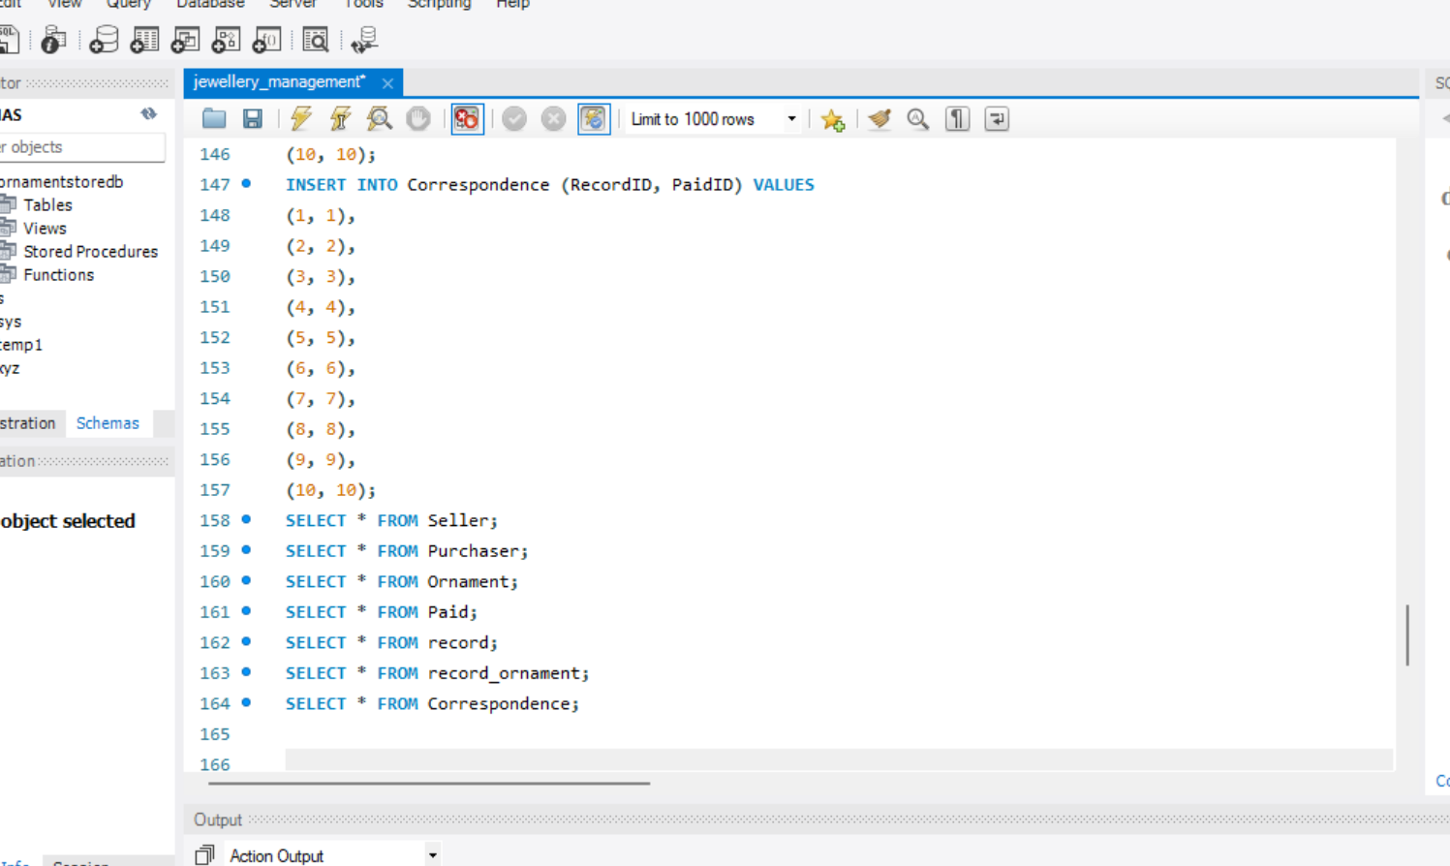

Slide 13
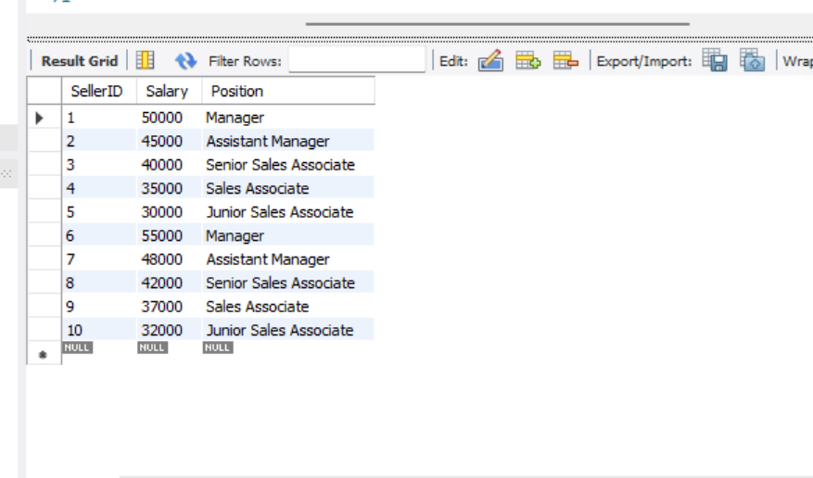
Table Views:

Slide 14
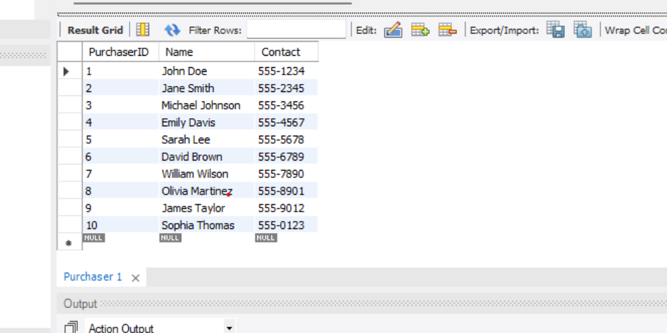

Slide 15
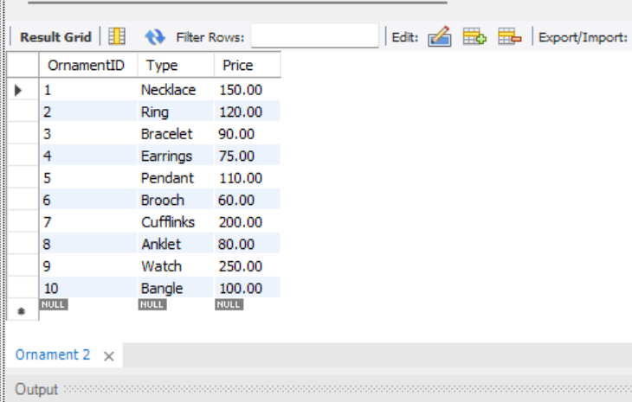

Slide 16
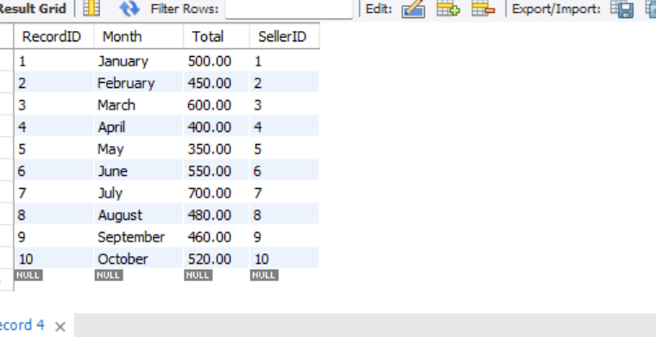

Slide 17
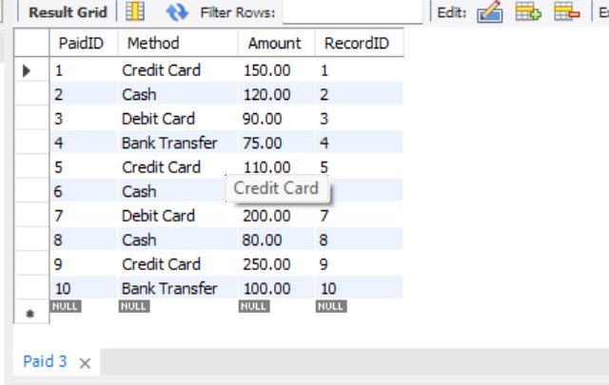

Slide 18
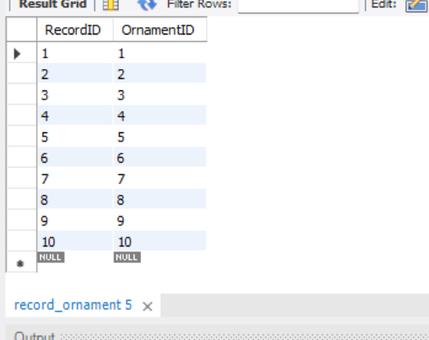

Slide 19
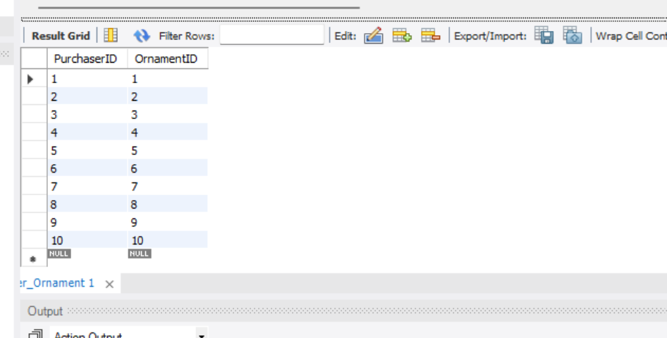

Slide 20
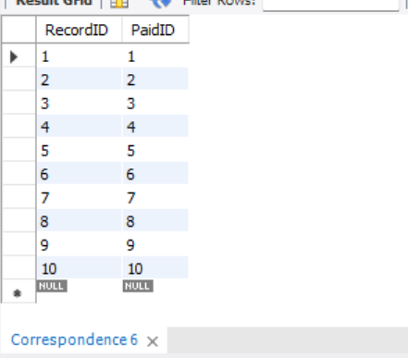

Slide 21
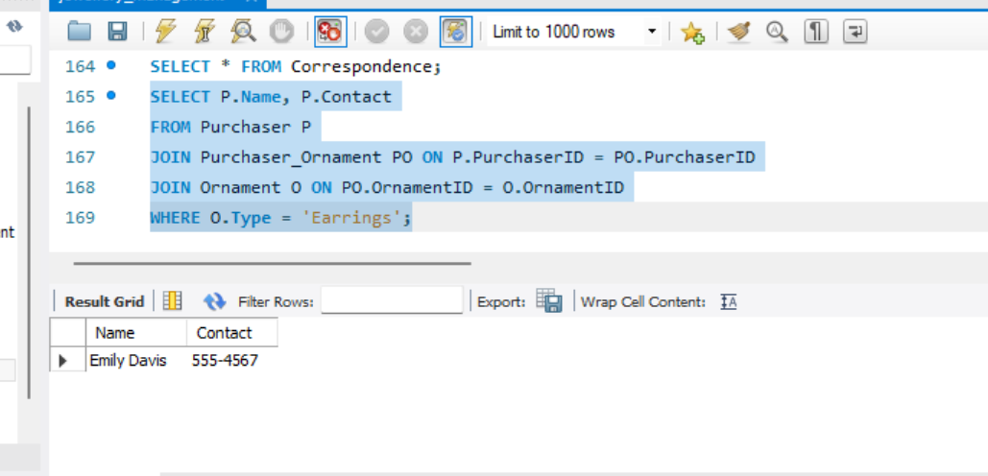
Queries to test our database:
1. Find the Purchaser who purchased Earrings.

Slide 22
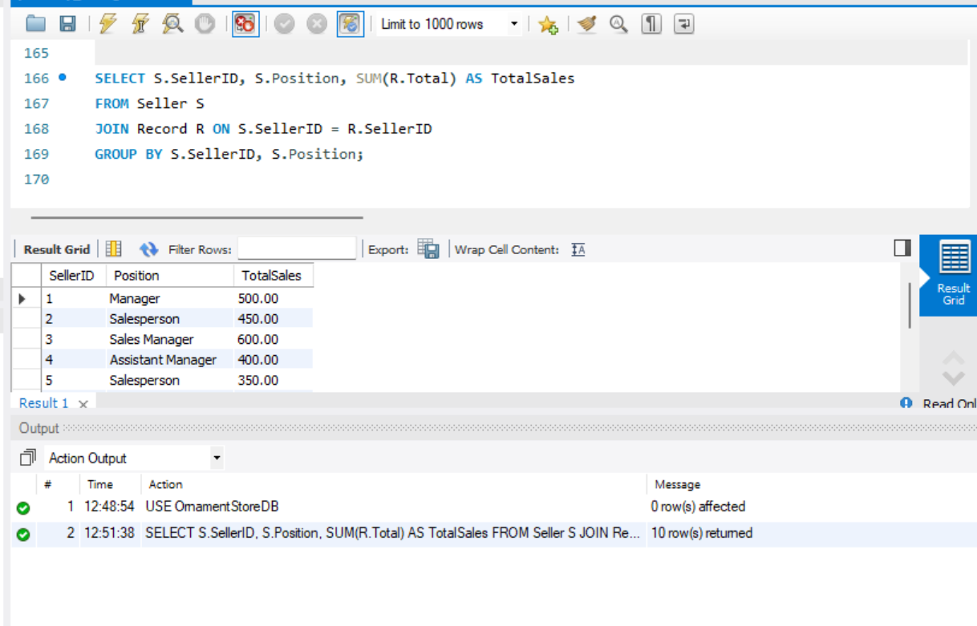
2. Find the Total Sales made by each Seller (of any position in our small shop).

Slide 23
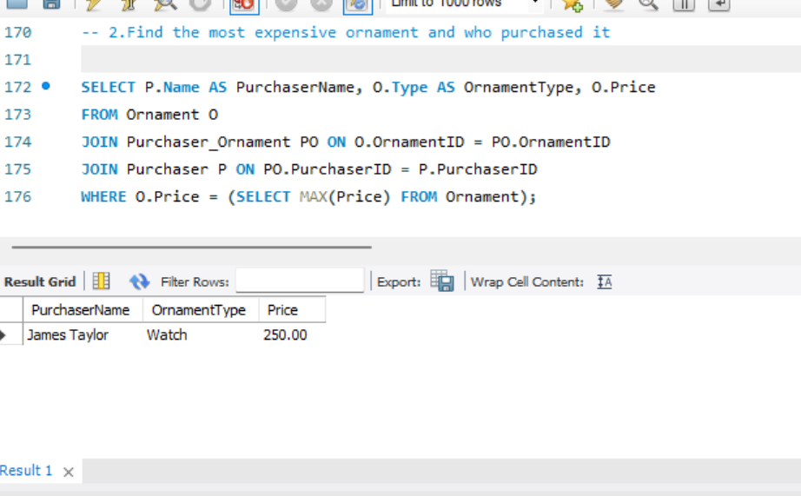
3. Find the most expensive Ornament and who purchased it.

Slide 24
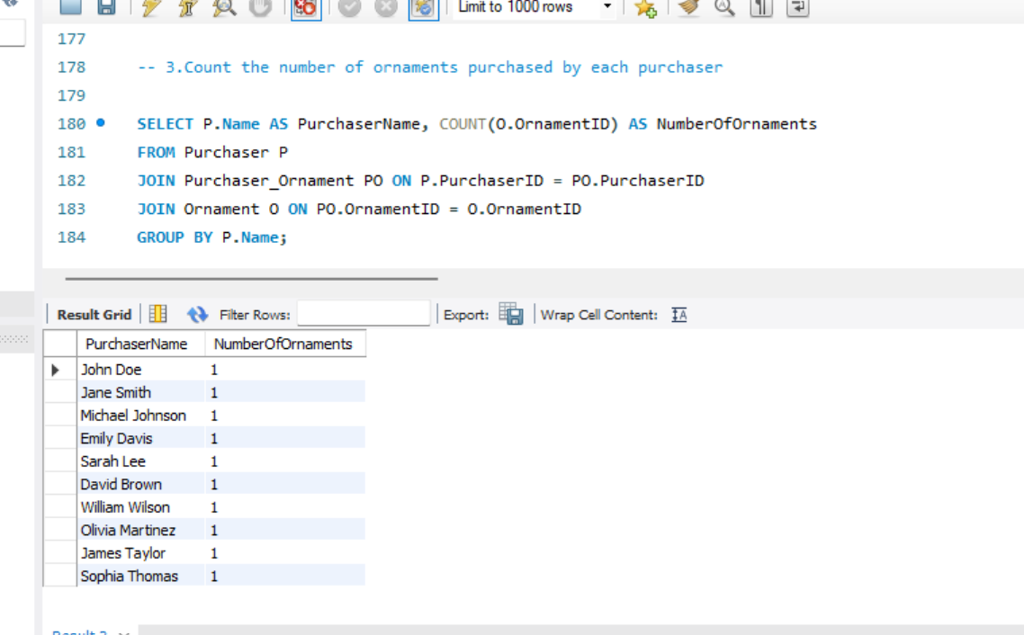
4. Count the number of Ornaments purchased by each Purchaser.

Slide 25
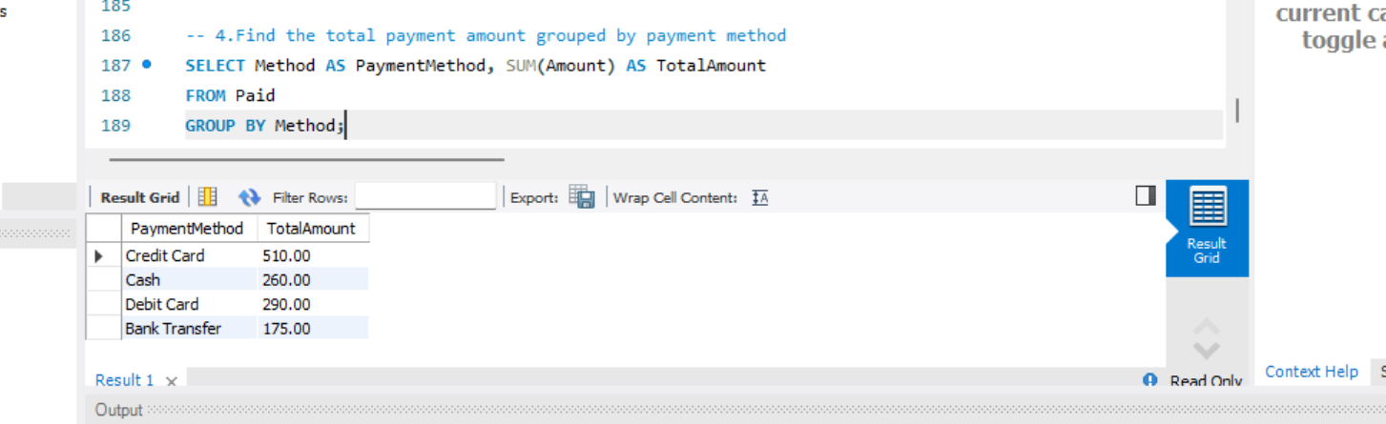
5. Find the total Amount paid through each payment Method.

Slide 26
Do you have any questions?

Slide 27
Thank you!

